Slide 1
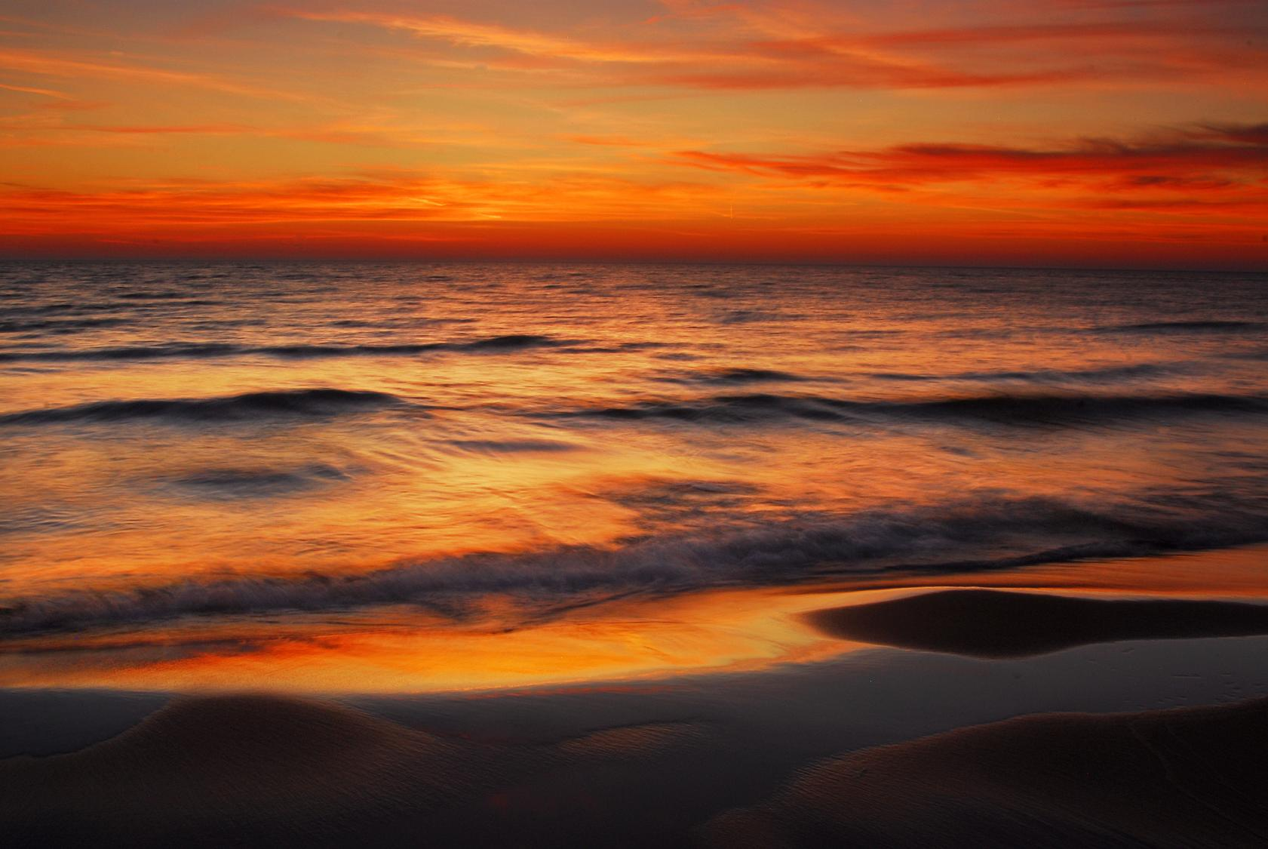
Cumulative Impact Assessments— Overview of Past Cumulative Impact Assessments and Future Scientific Needs
Meeting of the Regional Body and Compact Council Science Team
Detroit, Michigan
September 17, 2019
Jim Nicholas

Slide 2
Requirement for CIA
Every 5 years, or
Trigger level of 50 mgd change, or
Request of a Party
Notes:
Historical dates = next CIA
No power Quebec and PA; no data yet from ON on future plant retirements

Slide 3
Approach
Report at GLB scale and each of 5 Watersheds
Use available Federal and Party data
Cumulative impact is comparison of Diversion + Consumptive Uses (CU) to Basin inflows and outflows
Notes:
Historical dates = next CIA
No power Quebec and PA; no data yet from ON on future plant retirements

Slide 4
Approach
Notes:
Historical dates = next CIA
No power Quebec and PA; no data yet from ON on future plant retirements

Slide 5
Data and Sources
Runoff, Precip, Evap, WL—GLERL
CC flows—Corps (Coordinating Committee)
St. Lawrence @ Trois Rivieres—EC (modeled)
Diversions and CU—each Party
Notes:
Historical dates = next CIA
No power Quebec and PA; no data yet from ON on future plant retirements

Slide 6
Reports
2006-2010—Included detailed error-checking of diversion and CU data in GLC database
2011-2015—Used diversion and CU data from annual GLC Water Use reports
Annual summaries in annual GLC Water Use reports due to 50 mgd trigger
Notes:
Historical dates = next CIA
No power Quebec and PA; no data yet from ON on future plant retirements

Slide 7
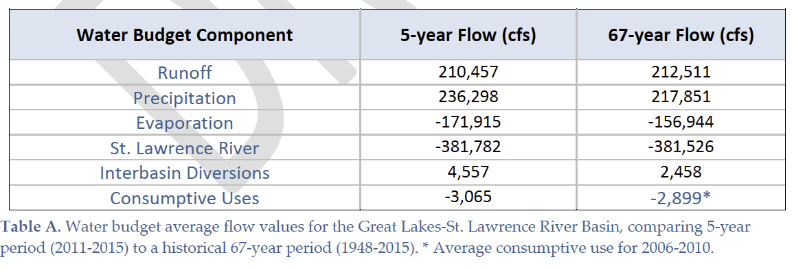
Results for Great Lakes Basin
Notes:
Historical dates = next CIA
No power Quebec and PA; no data yet from ON on future plant retirements

Slide 8
Results for Great Lakes Basin
Notes:
Historical dates = next CIA
No power Quebec and PA; no data yet from ON on future plant retirements

Slide 9
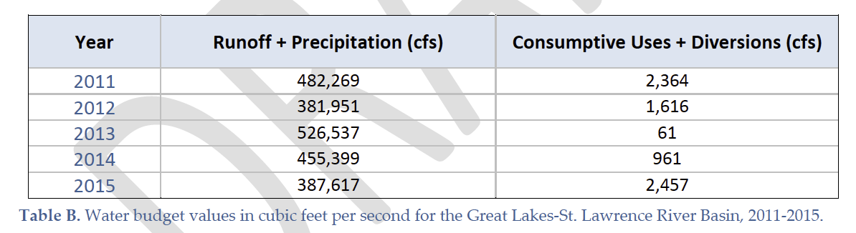
Results for Great Lakes Basin
Notes:
Historical dates = next CIA
No power Quebec and PA; no data yet from ON on future plant retirements

Slide 10
Future Possibilities
Improve CU estimates/measurements for one or more major CU categories
Consider Cumulative Impact by water source (GL/CC, GW, OSW)
Use data from Large Lake Statistical Water Balance Model (L2SWBM), incorporating probabilistic range of values, for Runoff, Evap, Precip, and CC flows
Similarly treat diversions and CU?
Notes:
Historical dates = next CIA
No power Quebec and PA; no data yet from ON on future plant retirements

Slide 11
Future Possibilites
Current CIA reports show a graph of historical and 5-year water levels for the 4 GLs and state “The specific contribution made by Diversions and Consumptive Uses at any given point in time or space, separate and apart from natural variability, is uncertain given the complex hydrologic, geographic and temporal variability of uses, and other factors. Since Diversions and Consumptive Uses are small compared to natural flows, their cumulative hydrologic effect on water levels is likewise small.”
Can L2SWBM be used to tie CU to water levels?
Notes:
Historical dates = next CIA
No power Quebec and PA; no data yet from ON on future plant retirements

Slide 12
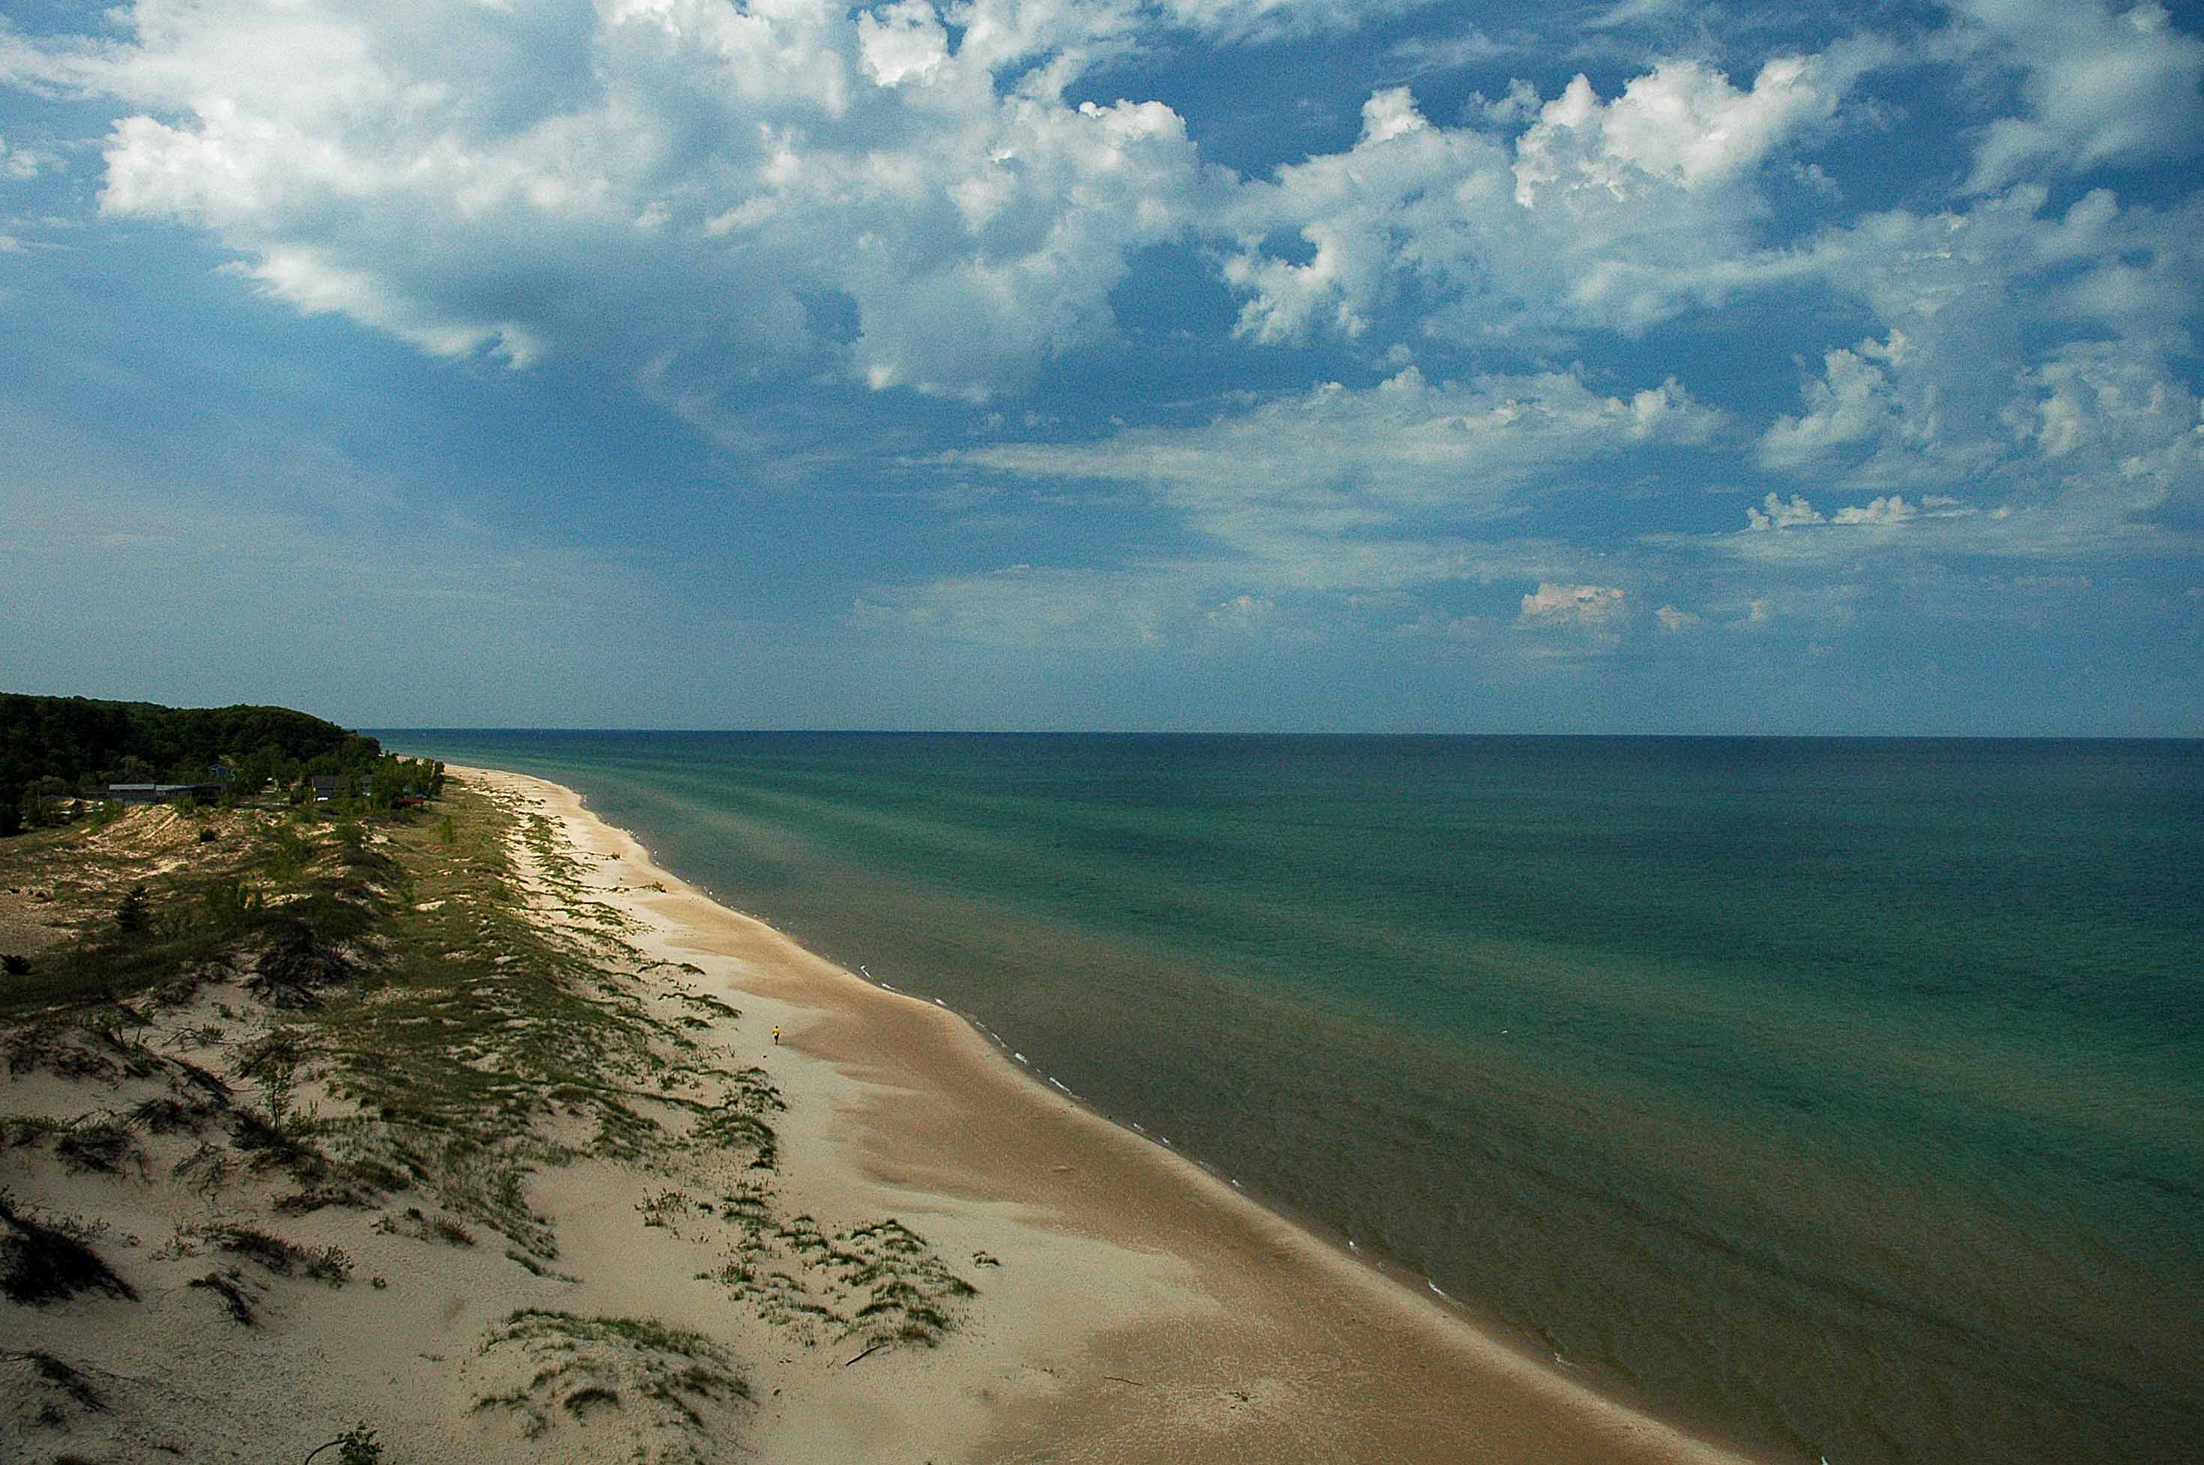
Questions/Discussion

