Slide 1
Meeting of
Regional Body and Compact Council Science Team
September 17-18, 2019
The Great Lakes-St. Lawrence
Water Use Repository—current overview
and additional needs
Tom Crane
Great Lakes Commission

Slide 2
History of the Great Lakes-St. Lawrence Regional Water Use Database
Managed by the Great Lakes Commission (since 1988).
GLC serves as the data base repository under a MOU with the
Great Lakes-St. Lawrence Governors and Premiers
Supports the states and provinces in implementing:
  Article 4 (Water Management and Regulation) of GL-SL River Basin Water Resources Compact
  Article 301 (Information) of the GL-SL River Basin Sustainable Water Resources Agreement.
Reports for years 1987-1993 and 1998-2014
2009 Water Use Data Protocols define the responsibilities of the States and Provinces to provide data
Protocols fully implemented beginning with the 2012 Annual Report

Slide 3
Article 301 and Section 4.1
Develop and maintain a water resources inventory of compatible water use information
Report on all diversions and withdrawals and consumptive uses in excess of 100,000 gallons per day (379,000 litres per day)
Report aggregated information annually to the parties and available to the public
Help the parties to improve the sources and applications of scientific information regarding the waters of the basin and impacts of withdrawals and diversions from various locations and sources

Slide 4
Database Contents
Measures
Withdrawals
Consumptive use
Use Sectors
Public water supply
Watersheds
Diversions in/out of the basin
Intra-basin diversions
Commercial and institutional
Power production (once-through cooling)
Irrigation
Livestock
Industrial
Power production (recirculated cooling)
Off-stream hydroelectric power
In-stream hydroelectric (optional)
Other
Lake Superior
Lake Michigan
Lake Huron
Lake Erie
Lake Ontario
St. Lawrence River
Jurisdictions
Illinois
Indiana
Michigan
Minnesota
New York
Ohio
Ontario
Pennsylvania
Quebec
Wisconsin

Slide 5
Annual Database Update Schedule/Process
May - August
August
September
Jurisdictions collect data
Data submitted to GLC
Report drafting & review
QA meetings with jurisdictions
Data updates
Final report & database release
September
October - November
December
Notes:
QA meetings w/ jurisdictions = GLC staff collect metadata from water use managers
Helps explain changes in data
Explain outliers or anomalies
Reviewed by GL Compact Council and Regional Body
Final report is presented to the Compact Council and Regional Body
Regional Body was established by the GL-SL River Basin Sustainable Water Resources Agreement
Compact Council was established by the GL-SL River Basin Water Resources Compact

Slide 6
What’s Gone Well?
Since 2012, data quality has improved.
Improved compliance in water use data collection and reporting
Improved documentation of data sources
Higher commitment/investment by states and provinces in their water use data collection and reporting programs

Slide 7
Ongoing Needs/Areas for Improvement
Improve consumptive use reporting; encourage more direct measurement, more refined estimation protocols and greater consistency in use of coefficients across categories
More detailed diversion reporting
Invest time and resources to research and better explain unexpected/unusual changes in data from one year to the next
Continued commitment to improve data collection and reporting; especially for specific categories (i.e., self-supply irrigation and self-supply livestock)

Slide 8
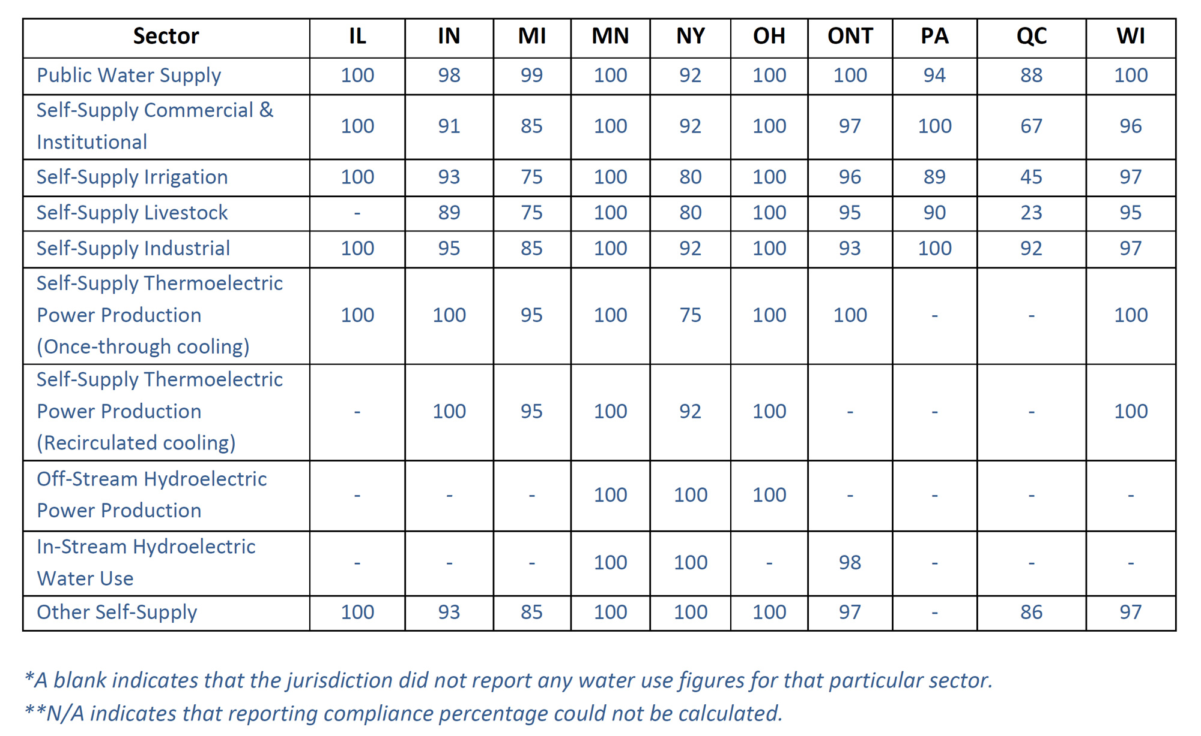
Reporting Compliance by Water Use Sector

Slide 9
Issues To Be Addressed:
Opportunities to Support the Science Strategy
Consider ways that the database can better support the 5-year Cumulative Impact Assessments
Encourage and support sector based research especially related to consumptive use
  Thermoelectric power production (cooling)
  Agriculture and livestock production
  Public water supply
Reexamine the benefits of reporting data on a
sub-watershed scale

Slide 10
Questions?
    Thomas R. Crane
    Deputy Director
    Great Lakes Commission
    1300 Victors Way, Suite 1350
    Ann Arbor, MI 48108
    734-971-9135, ext. 6062
    tcrane@glc.org

