Slide 1

Great Lakes Compact
AWWA Water Audits
Why and how should audits be performed?
  John H. Van Arsdel, Vice President
  john@mesimpson,com

Slide 2
Gallons of water being pumped into the distribution system
each billing period exceeds the gallons being sold.
Water Sold
Water Pumped
Notes:
Water Utilities have been trying to balance the scales for years!

Slide 3
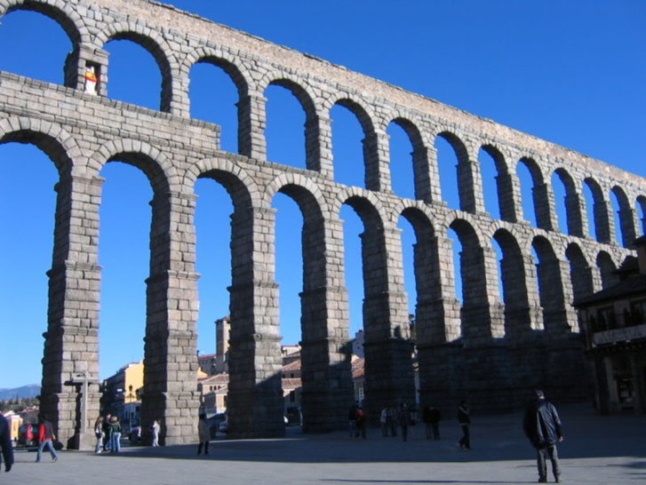
Water Loss Control
Monitoring water resources has been conducted for thousands of years.
Roman Adjutage
Julius Frontenus was first Roman Water Commissioner and recognized importance of equitable water distribution (300 BC)
Flow
Notes:
The Romans understood why water equity was needed for the civilization to be able to function. They understood the protection of the Commons.

Slide 4
Water Loss Control
Concept of “water rights” and efficient water use has been debated and fought over for centuries
End result: majority of water is now metered for equitable economic distribution.

Slide 5
Water Produced never equals Water Consumed…
Where did it all go??
Water Sold
Water Pumped
Notes:
Well… where did it all go?

Slide 6
Local Consideration…
In 2015, Indiana utilities produced over 50 billion gallons of water that did not generate revenue, resulting in a loss of $54.6 million (2016 Evaluation of Indiana’s Water Utilities Report).
This prompted a reaction…

Slide 7
A little History…
(2016)
Senate Enrolled Act No. 347 required all public water utilities in the State of Indiana to provide the Indiana Finance Authority (IFA) with a Non-Revenue Water Audit, as identified in the American Water Works Association Manual of Water Supply Practices M-36
The act also required the IFA to conduct a study and analysis of infrastructure needs for all water utilities in the State of Indiana
The final report was submitted to the legislative services agency. The report is available at the IFA website.

Slide 8
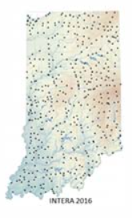
A little History…
552 utilities were represented in the final dataset
Senate enrolled Act 416: Infrastructure Assistance Fund was passed into law (Public Law 233) on April 28, 2017. This law was guided in part by the work of this study.
Begin evaluating regionalizing utilities to improve efficiency
Assist utilities with future water auditing needs

Slide 9
A little History…
To better understand non-revenue water, the Indiana Legislature enacted SEA 4 (2019), which obligates water utilities to complete annual water audits.
In addition, in every even-numbered year, starting in 2020, the water audits are required to be validated by a certified, third party water audit validator (“Certified Validator”) and submitted to the IFA for compilation into a biennial report to the General Assembly. The IFA will aid utilities in completing their validated water audits.
IFA has contracted with the Indiana Section of the American Water Works Association and its partners, to provide training and assistance to help utilities meet the requirements of SEA 4.

Slide 10
Water Audit History
AWWA Teamed with IWA to formulate methodologies for water loss auditing.
Began in 2001
Looked at current practices and available data

Slide 11
AWWA “States Survey” Project (2001)
State Regulations
20%
15%
10%
15%
15%
20%
15%
20%
15%
15%
15%
15%
10%
10%
15%
15%
15%
7.5%
10%
20%
15%
10%
“A better system of accounting is needed to instill better accountability in drinking water utilities”

Slide 12
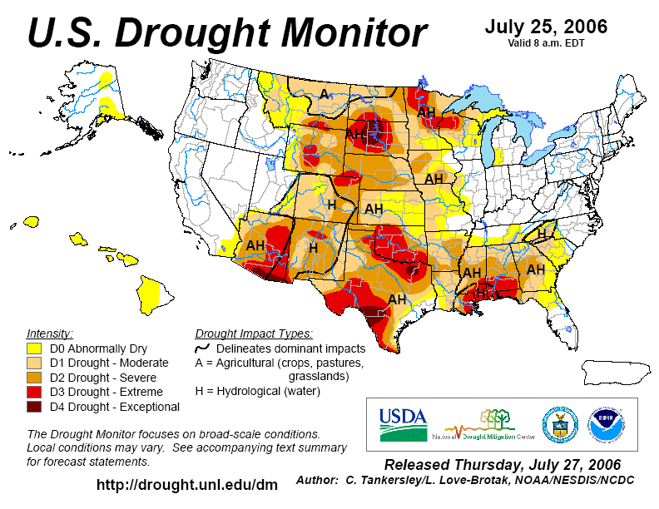
Growing Pressure to Manage Water More Efficiently
Note that he drought status has shifted more to the western states since 2006!
Notes:
Utility operators have “fudged” percentage numbers for decades

Slide 13
AWWA “States Survey” Project (2001)
Covered
Ten Practices
Water loss policy
Definition of water loss
Accounting and reporting
Standards and benchmarks
Goals and targets
Planning requirements
Compilation and publication
Technical assistance
Performance incentives
Auditing and enforcement
Find the report and data at:
http://www.awwa.org/Sections/committee/committee_view.cfm?hpid=30

Slide 14
Who Made the Rules??
In the United States, no national regulations exist to require drinking water utilities to report annual water audit data or contain their losses to economic levels.
As water resource shortages continue to become more prevalent and severe, it is likely that many more state and regional agencies will set forth requirements to compile an annual water audit.

Slide 15
Water Loss in the Past: unstructured, reactive
No consistent definitions for the various components of use or loss had been employed
Worldwide, no standard definition had been found to exist for the term “unaccounted-for” water
Percentage indicators have been found to be suspect in measuring technical performance
Percentage indicators translate nothing about water volumes and costs
Many water utilities have no active functions to assess or control losses

Slide 16
Early AWWA Water Loss Control Committee Initiatives
States Survey Project (2001)
WATER:/STATS Distribution Survey (2003)
Committee Report “Applying Worldwide Best Management Practices in Water Loss Control” (2003)
Free Water Audit Software Package (2006)
Contribution to AWWA M52 Publication: “Water Conservation Programs – A Planning Manual” (2006)
Completed: rewrite of the AWWA M36 Publication “Water Audits and Leak Detection” 2009, 2016, under current revision

Slide 17
Promoting Water Efficiency in the US
State of Texas Water Audits – data collected for 2005; analysis results by early 2007
Delaware River Basin Commission – assisted development of Water Audit Software; moving to revise existing water conservation resolutions
Metropolitan North Georgia Water Planning District – requires use of new AWWA methods for +60 regional water utilities
Water Utilities - Philadelphia, Nashville, American Water, Cleveland, San Antonio, Detroit, Ft. Worth, Seattle, El Dorado Irrigation District, WCSA (Abingdon VA)

Slide 18
Promoting Water Efficiency in Canada
National Research Council Canada issued InfraGuide: Canadian national guide to sustainable municipal infrastructure
www.infraguide.gc.ca
Water Loss Control Initiatives
  Halifax Regional Water Commission (North American leader in leakage control)
  Toronto, Region of Peel Ontario
  Launching initiatives - Montreal, Calgary, Winnipeg, St. Catharines, others

Slide 19
Understanding Sources of Water Losses

Slide 20
  Cost of water loss
  Water waste
If treated water, real losses waste
  chemical treatment
  electricity
  wear and tear on equipment
If purchased (importing) water, real losses waste
  the direct purchase cost of leaking water
  subsequent pumping costs if applicable
Lost revenue from unauthorized consumption, inadequate billing process and customer meter inaccuracies
Notes:
Water not measured and charged to the customer costs money to produce and send into the system. Systems that purchase finished water tend to pay much more for their water and so the cost of leaks and other non revenue water tends to be higher and of greater concern. Surface water supplies tend to cost more than groundwater to produce. If the billing system and meters of small systems are a source of loss, the value of the water lost is costing revenue, losing money at the customers’ billing rate. If there is theft, the same opportunity to bill is lost and is costing the small system at this higher rate.

Slide 21
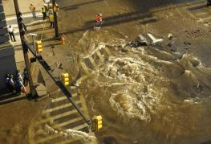
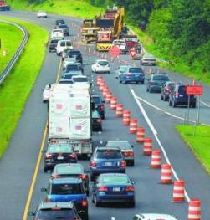
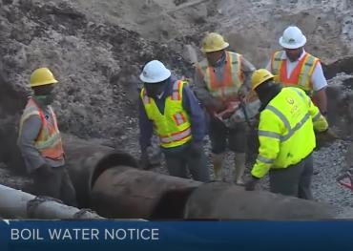
Cost of water loss
Damage
Physical damage
  Damage to property and other utilities
  Hazards – erosion, ponding, hydroplaning
Interruption to Commerce and the Environment
  Traffic interruption
  Loss of water can interrupt business
Water quality
  Disturbing pipe wall tuberculation
  Backflow
  Contamination, Boil Water Orders
Photo courtesy NJ American Water
Photo courtesy Frederick Post Dispatch
Photo courtesy WPTV television, West Palm Beach
Notes:
Water leakage goes beyond waste as it has potential to do damage and create hazards. Small systems are more prone to overuse their water supply if there is a hidden major break. Bad leaks have the potential to allow contaminants into the water system and the EPA appears to have some increasing interest in water quality issues in the pipe network especially contamination from intrusion and backflow. The leak in the center picture is directly below a joint in a sewer pipe – in this case it is a storm sewer. That is a tiny jet of water from the iron pipe hitting the bottom of the concrete pipe and then spraying and flowing away from the pipes.

Slide 22
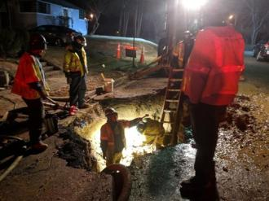
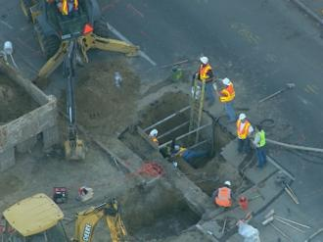
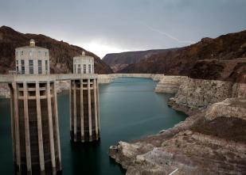
Cost of water loss
Resource Allocation
Labor force
  Staff needed to locate and repair leaks, restore the environment
  Added emergency conditions expose to staff to higher risk activity
Supplies and Equipment
  Inventory of repair parts needed for a variety of possible failures
  Equipment needed to support staff 24/7
Water supply
  Systems with limited water can be threatened
  Excessive loss can accelerate the need for more resources, facilities and capital expense.
  Strains existing water resources, may limit growth
Photo courtesy City of Arlington, VA
Photo courtesy CBS$ Denver
Photo courtesy Denver Post
Notes:
Water leakage goes beyond waste as it has the potential to use up a utility’s limited resources which includes labor, equipment and material. Most critically, it may tax the limited water resources available.

Slide 23
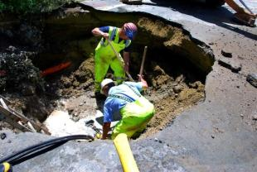
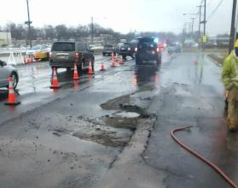
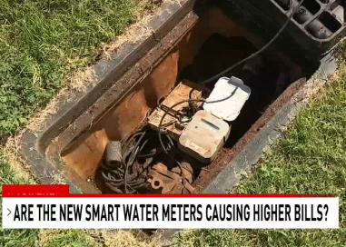
Cost of water loss
Customer perspective
Heightens inconvenience from interrupting water service and commerce
Hurts perception of utility as a steward of resources (environmental and financial)
Brings unwanted, negative publicity
Where metering is inaccurate, inequities occur
Photo courtesy California American Water
Photo courtesy NJ American Water
Photo courtesy KTXS television Abilene, TX
Notes:
Utilities should know customers see how water is wasted. Visible loss and high costs will impact the customers view if there is an impression of misusing a precious resource and customer payments for service. Ask audience how popular a main break or hydrant flushing program is in a drought condition . The picture at the right is the helicopter view from a TV news program.

Slide 24
The Water Audit
An audit is an examination of records, documents, and data conducted in order to track the management of resources
In the water audit, the supplied water and costs are the resources
AWWA advocates that water utilities compile the water audit annually as a standard business practice

Slide 25
How the Audit Works
Water Supplied – Authorized Consumption = Water Loss
Authorized Consumption = Billed Metered + Billed Unmetered + Unbilled Metered + Unbilled Unmetered
Water Loss = Apparent Losses + Real Losses
Each area has various components that can be analyzed
(Thus the term: Component Analysis)
Each area will be examined in detail during the audit process
Notes:
Explanation of Terms.

Slide 26
The AWWA Water Audit
Getting a handle on water loss
How much is lost?
Where is it lost?
What is that loss costing?
Is it leaks, unauthorized consumption, inaccurate meters? (often it is a combination of all of these)
Notes:
So the critical questions to ask about water waste addressed by the audit is how much and where is the water loss.

Slide 27
IWA/AWWA Standard
Water Balance Format (2003)
Start here
Move this direction
Water
Exported
Authorized
Consumption
Total
System
Input
(allow
for
known
errors)
Authorized
Consumption
Billed
Authorized
Consumption
Revenue
Water
Billed Water Exported
Own
Sources
Total
System
Input
( allow
for
known
errors )
Water
Exported
Water
Supplied
Billed Metered Consumption
Water
Supplied
Billed Unmetered Consumption
Unbilled
Authorized
Consumption
Non-
Revenue
Water
Unbilled Metered Consumption
Water
Imported
Unbilled Unmetered Consumption
Water
Losses
Water
Losses
Apparent
Losses
Unauthorized Consumption
Customer Metering & Data Inaccuracies
Real
Losses
Leakage on Mains
Leakage on Service Lines
(before the meter)
Leakage & Overflows at Storage
Notes:
Practices for the water audit are based on this Water Balance Start on the left… move right.

Slide 28
AWWA Water Loss Control Committee’s Water Audit Software
Launched April 2006
Available for FREE download
Simple, user friendly: good for top-down audit
“Beta tested” by 21 water utilities during 2005
WLC Committee provides user support and continuous future upgrades
Version 6 is the current version

Slide 29
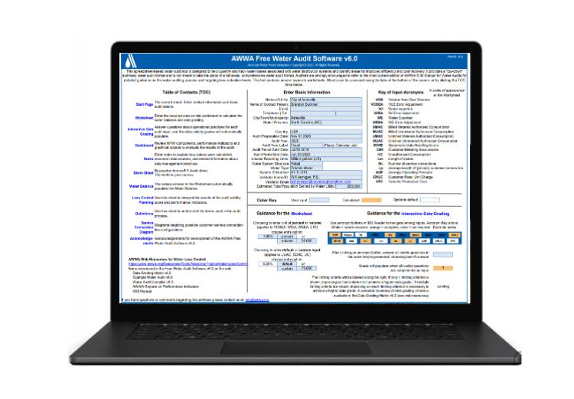
AWWA Free Water Audit Software
Version 6.0 released 2020
Notes:
Now there is an AWWA methodology that uses a FREE spreadsheet available on the internet complete with economic considerations and instructions. You may wish to consider this option or you may be mandated to use it, so it is included in the training module

Slide 30
How to Get the Free
AWWA Water Audit Software
Go to awwa.org
Select Water Loss Control from the Resource and Tools menu
Scroll down to the Tools for Water Audit Analysis and select AWWA Free Water Audit Software (v6.0 2020)
Fill out online form (name, address, etc.) to download the FWAS v6
Notes:
So here is the process in one page

Slide 31
Water Audit Process: A Top Down Approach
Advantage: quickly pulls together data and information that is readily available.
Disadvantage: for most water utilities, incomplete or inaccurate data limits the validity of the top-down water audit.
Notes:
Top down approach get things started. You just need to start even if you have limited records.

Slide 32
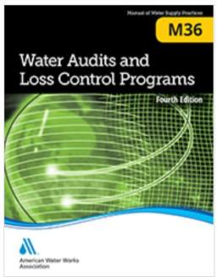
AWWA tools for Non-revenue Water Management
AWWA Manual M36, 4th edition (2016)
  5th edition currently being prepared,
  Free software available on AWWA website:
https://www.awwa.org/Resources-Tools/Resource-Topics/Water-Loss-Control
The AWWA Water Loss Control Committee (WLCC) develops and updates supporting software and research efforts
AWWA M36 manual
Notes:
There is also a manual that describes various aspects of controlling water loss with a section on small systems that acknowledges some key differences.

Slide 33

The water audit is fed by data
reliable results come from trustworthy data
How much water do you send out?
  Water produced and sent into system
  Purchased (imported) water
How much water reaches customers?
  Metered and unmetered
  Billed and unbilled
How much water is used but not billed?
  Flushing
  Municipal uses (firefighting, street cleaning, etc.)

Slide 34
Completing the Water Audit
Decide who will be in charge of the Audit for the Utility.
Form a Committee. Input needed from:
Water Production
Billing
Distribution
GIS
Engineering
Proper input is needed from everyone to ensure success!

Slide 35
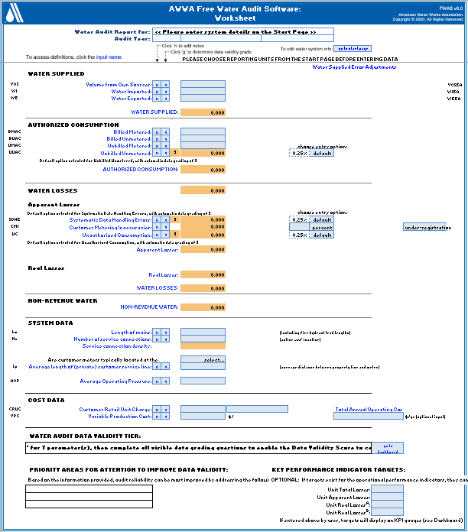
Version 6 Worksheet
Water Supply Data
Authorized Consumption
Water Losses
System Data
Cost Data

Slide 36
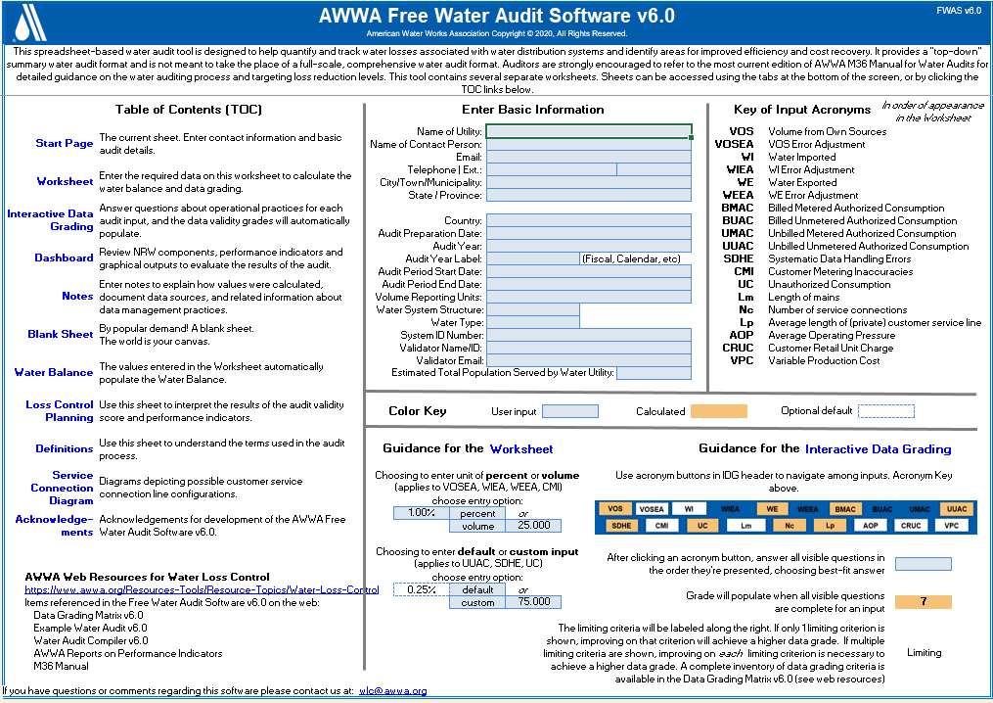
The Water Audit Process
….. and “SAVE” a copy to your computer…
Notes:
Start exploring a reading.

Slide 37
Completing the Water Audit
Read the instructions provided in the software
Follow the tabs

Slide 38
What data do I need?
System Schematic
Elevated Storage Tank
Export Water Meter
WTP
Zone 1
Finished Water Meters
Zone 2
Export Water Meter
Well Field
Ground Storage Tank
Import Water Meter
Booster PS

Slide 39
What data do I need?
Water Supplied
Source meter data (Million gallons per year)
All amounts of water produced at a treatment plant
Data from meter testing and calibrations and year completed
Million gallons per year of water purchased (if any)
Million gallons per year of wholesale water sold (if any)
Notes:
Start gathering data. Filling out the form is easy, but gathering the data is very tough. You will need access to a lot of different stuff.

Slide 40
What data do I need?
Authorized Consumptions
Million gallons per year of water delivered and billed - metered
Million gallons per year of water delivered and billed – unmetered
Million gallons per year of water delivered but unbilled – metered
Million gallons per year of water delivered but unbilled – unmetered
Notes:
All of this data is needed to calculate loss both in actual water volumes as well as dollars.

Slide 41
What data do I need?
Apparent Loss
Estimates of Unauthorized Uses
Meter Inaccuracies for meter population
Estimates of Systematic Data Handling Errors
Notes:
All of this data is needed to calculate loss both in actual water volumes as well as dollars.

Slide 42
What data do I need?
  Physical parameters of the water system
    Length of mains
    Number of service connections
    Average length of customer service line
    Average system operating pressure
  Financial data on the system
    Annual operating costs (salaries, operation & maintenance, extensions & replacements, bond repayment)
    Retail cost per unit
    Variable Production Cost – Cost for treatment + power from source to customer ($/MG)
Notes:
All of this data is needed to calculate loss both in actual water volumes as well as dollars.

Slide 43
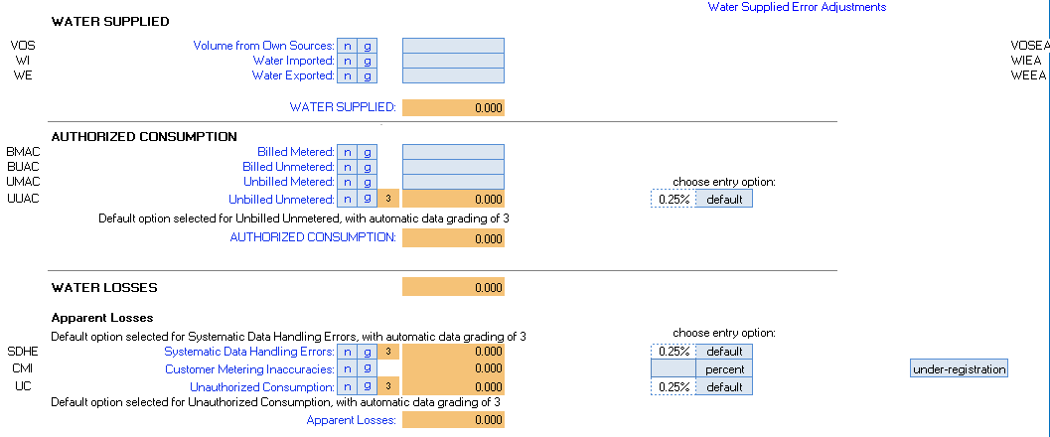
Where is the data entered?
  Look for the light blue boxes in the spreadsheet
The tan boxes are calculations that will be filled after the data is entered
Notes:
Start entering data in the white cells.

Slide 44
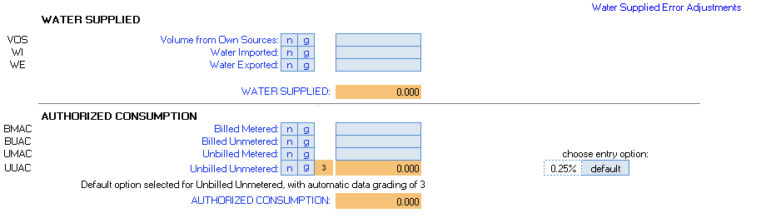
Where is the data entered?
  Look for the light blue boxes in the spreadsheet
That was easy… but what about the small light blue boxes with letters?
Notes:
Start entering data in the white cells.

Slide 45
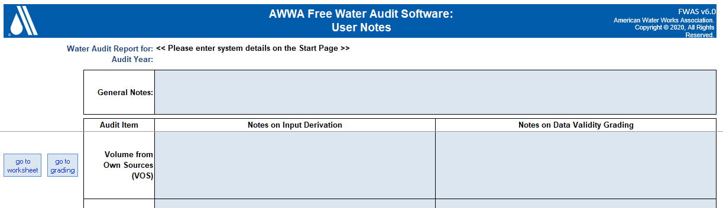
Keeping Notes on the Data
The “N” stands for Notes. This page opens when the auditor clicks on the “N”.
The Auditor can keep notes on Data Derivation as well as notes on items that affect Data Validity Grading

Slide 46
Grading the Data
By clicking on the “G” box the auditor can grade the data entry.
For V6 there is a different way to grade the data whereby the Auditor can easily grade the data easier… than V5.

Slide 47
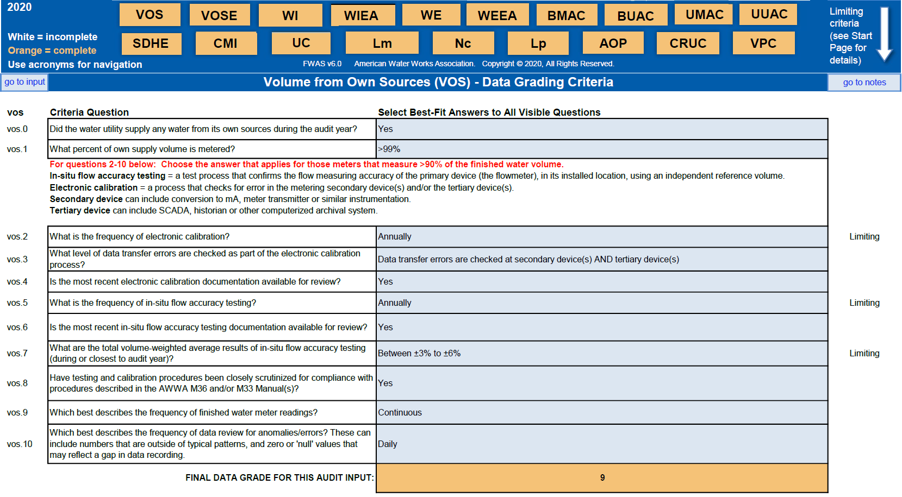
Interactive Data Grading Worksheet
Grading rates the trustworthiness (1-10) of data on a scale of 1-10, process-based
Answers to questions result in an assigned grading. Limiting condition is identified.

Slide 48
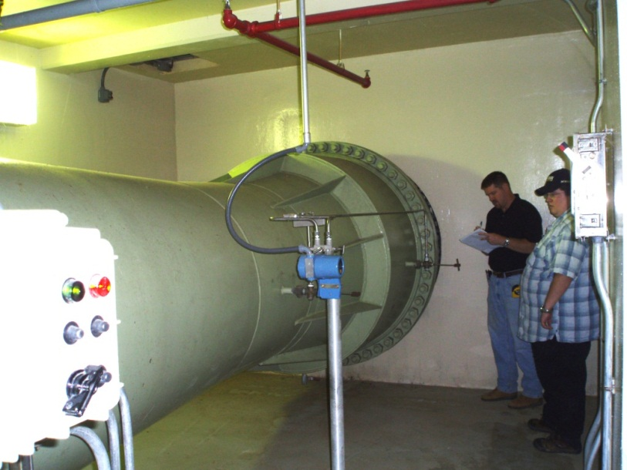
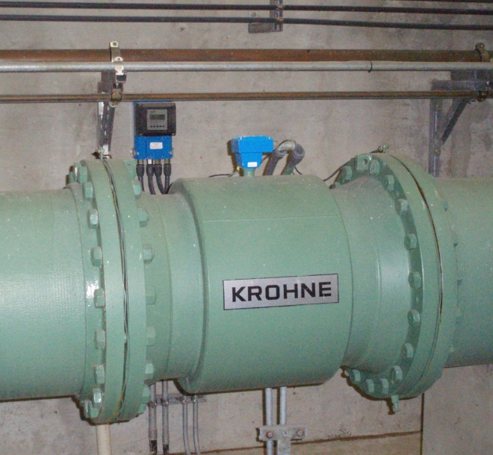
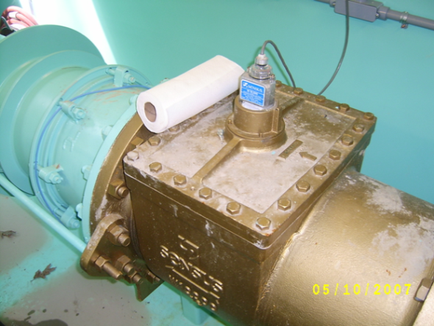
Production Venturi Meter
Production Mag Meter
Wholesale 16”Turbine meter
Notes:
Examples of various meters. Each has a specific function and if not measuring correctly can be a cause of serious issues for a utility.

Slide 49
Ongoing Water Audit Data Collection
Water utilities compile large amounts of data from information systems, including those listed below
Data | Information Source
Production flows, pressures | Supervisory Control and Data Acquisition (SCADA) systems
Customer meter data | Meter Management System or Customer Information System
Customer billing data | Customer Billing System or Customer Information System
System maintenance data | Computerized Maintenance Management System and/or Geographic Information System
Capital Program data | Capital Program Tracking System
Notes:
This slide is in another presentation

Slide 50
Monthly Tracking vs. the Annual Water Audit
Monthly | Annual
Volume from Own Sources* | Data Validity Score
Water Imported* | Customer Metering Inaccuracies
Water Exported* | Unauthorized Consumption
Billed Metered Consumption | Systematic Data Handling Error
Billed Unmetered Consumption | Length of Mains
Unbilled Metered Consumption | Number of Service Connections
Unbilled Unmetered Consumption | Average Operating Cost
 | Customer Retail Cost Rate
 | Variable Production Cost Rate
*+/- Master Meter & Supply Error Adjustment
Seven key volumes to assemble on a monthly basis!
If you track them each month, the annual Water Audit will be smooth!
Notes:
This slide is in another presentation

Slide 51
How did the system do?

Slide 52
Using Performance Indicators
Performance Indicators – relevant to the goals and programs of the water utility, but also relevant to comparisons with other utilities
Two primary uses:
  Performance Tracking – measuring the performance of a utility year-by-year
  Benchmarking – comparing standing with other water utilities and defining levels of best practice
Notes:
Revised. Toned down a notch

Slide 53

Percentage Indicators for NRW Assessment
“For every complex problem, there is a solution that is clear, simple, and wrong!”
H.L. Mencken
20th Century American Journalist
‘Unaccounted for water’ is a poor, imprecise term
Percentages are poor criteria and better KPIs exist!
Notes:
Toned this down a bit, several states’ regulations still uses this

Slide 54
Why water loss percentages just do not work!
The “unaccounted-for” water percentage:
  Water Supplied – Billed Authorized Consumption
  Water Supplied
Volumetric Percentages are misleading because:
  They are mathematically skewed by variations in total customer consumption
  They don’t uncover the individual components of NRW – mainly Apparent and Real losses
  They reveal nothing about water volumes or costs
  Actions successful in cutting losses may not show a reduced percentage
x 100%
Notes:
Removed the comment that NRW% calculation not actionable. Utilities have used % or at least volume NRW to take action (including Tucson Water). The numerator of the NRW% is still actionable by itself. The denominator is the poor choice

Slide 55
How percentage measures fail – an example
A water utility supplies an average of 6 million gallons per day (mgd) to a community. It bills the equivalent of 5 mgd. The NRW averages 1 mgd (6 mgd – 5 mgd). The “unaccounted-for” percentage is calculated as:
UFW % = (6-5) / 6 = 16.67%
A community works hard to conserve water and reduces demand from 5 MGD to 4.5 MGD while maintaining NRW at 1 mgd. The UFW% is now calculated as:
UFW % = (5.5-4.5) / 5.5 = 18.18%
It appears that the water utility has increased NRW by 1.5%
Misstated NRW increase = 16.67% - 18.18% = 1.52%
But the volume of Non-revenue water is still 1 mgd with the conservation. The NRW volume is unchanged but the UFW% misleadingly suggests that losses have increased. Customer consumption decreased notably, skewing the UFW%
The opposite can also occur: a notable increase in customer consumption can artificially decrease the UFW%, despite reductions in water loss volumes

Slide 56
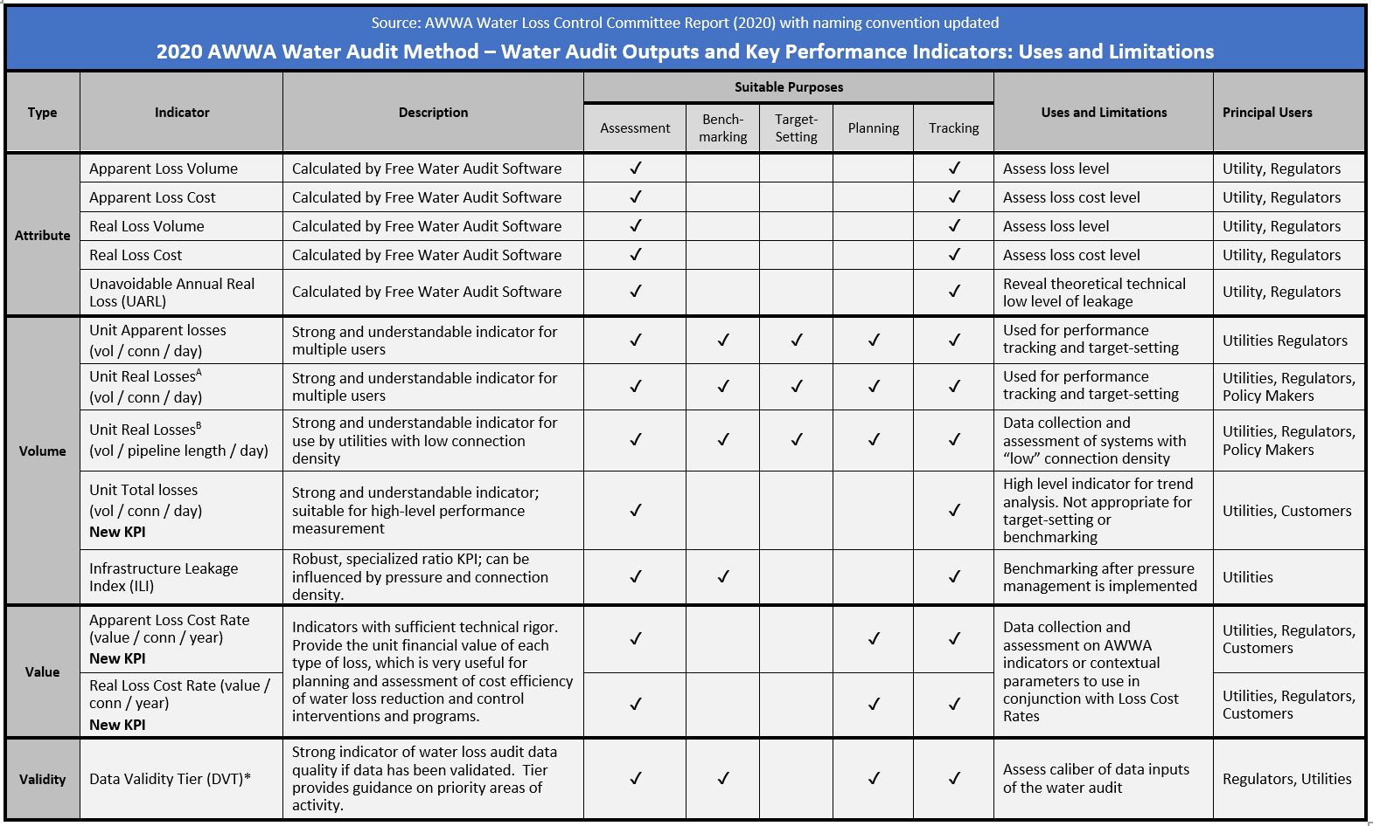
The AWWA NRW KPIs and Uses included on Dashboard Worksheet of FWAS
Different KPIs have different uses, although all are used in tracking

Slide 57
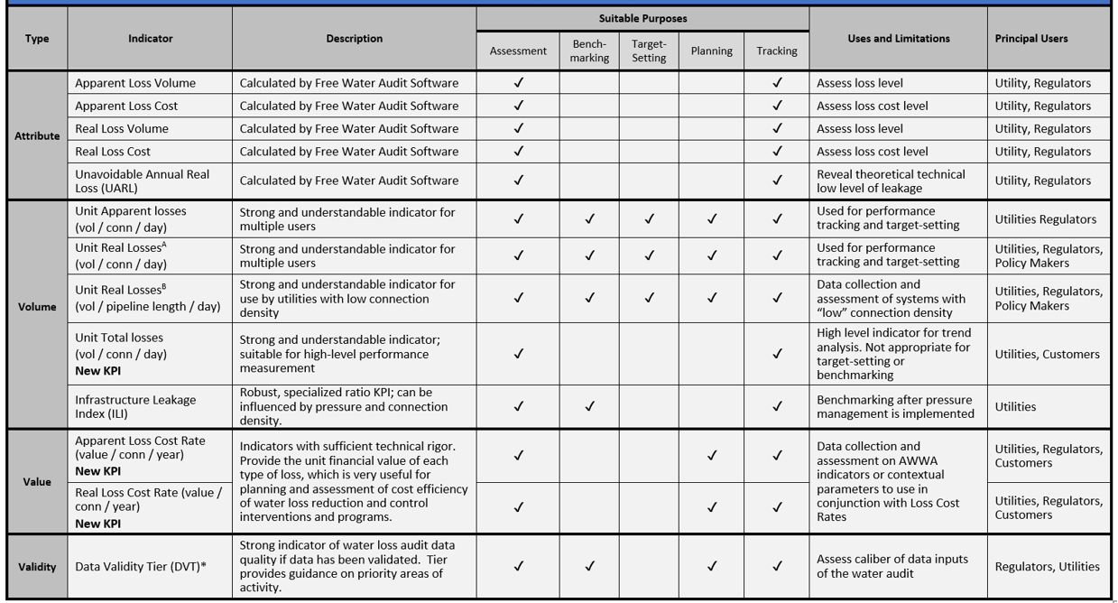
Notes:
Blew up contents of the previous slide for improved visual

Slide 58
AWWA NRW Key Performance Indicators
  Performance Indicators for Operational Efficiency
    Unit Apparent loss, gallons/service connection/day
    Unit Real loss (three forms)
      gallons/service connection/day -> best for tracking progress
      gallons/mile of pipeline/day
      gallons/service connection/day/psi of pressure
    Infrastructure Leakage Index (ILI), dimensionless
      Good benchmarking KPI; but should use only after any pressure management has been implemented

Slide 59
AWWA NRW Key Performance Indicators
  Infrastructure Leakage Index (ILI)
      The ILI is a dimensionless ratio and is calculated as:
      ILI = CARL (current annual real losses) / Unavoidable Annual Real Losses (UARL)
    Unavoidable annual real losses (UARL) is based on a tested formula and is calculated as follows:
    UARL (gal) = (5.4L_{m} + 0.15Nc + 7.5Lc) x P x 365 days/yr, where:
L_{m} = length of water mains (miles; including hydrant lead length)
Lc = Nc x Lp (average length, ft., of customer service line maintained by customers)
Nc = number of service connections
P = average operating pressure in the system (psi)

Slide 60
AWWA NRW Key Performance Indicators
UARL and the ILI
The UARL is a reference value that represents a theoretical lowest level of leakage that a water utility could reach if they were able exert all possible leakage controls, regardless of cost
Striving to reduce system leakage to a level close to the UARL (or an ILI close to the level of 1.0) is not necessary unless the water supply is unusually expensive, scarce or both
The UARL calculation may be skewed for very small (<3000 connections) or low-pressure water distribution systems (<35 psi)
Notes:
Simplified. Tucson will not have either condition to jeopardize the UARL unless we are analyzing a subsystem.

Slide 61
AWWA NRW Key Performance Indicators
Financial Performance Indicator
The Loss Cost Rate
  Expressed in $ per service connection per year
  Combines the rate of loss (gallons/connection/day) with
    the incremental production cost of water in $ per MG (real loss) or
    The retail cost per 1,000 gallon (apparent loss)
  Highest Loss Cost Rate values result from high rates of loss (apparent, real) and a high cost of water (apparent, real)
Notes:
Clarified retail and incremental production cost

Slide 62
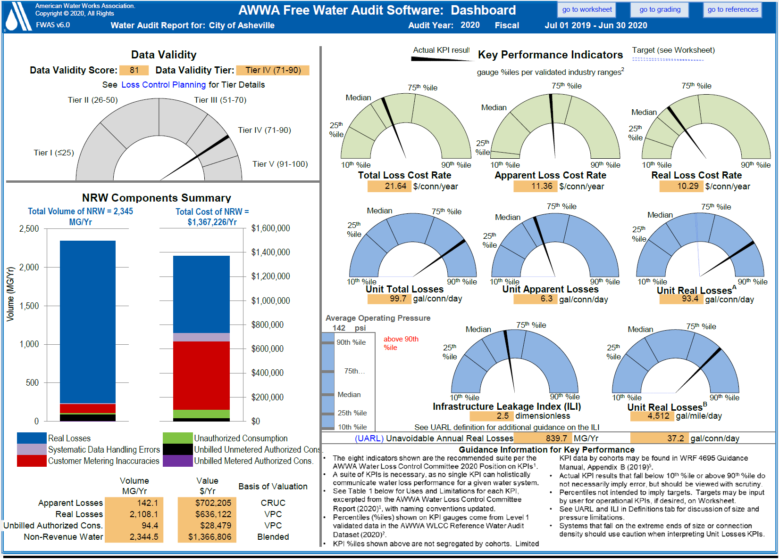
Target vs. Actual
Notes:
Blew up contents for improved visual

Slide 63
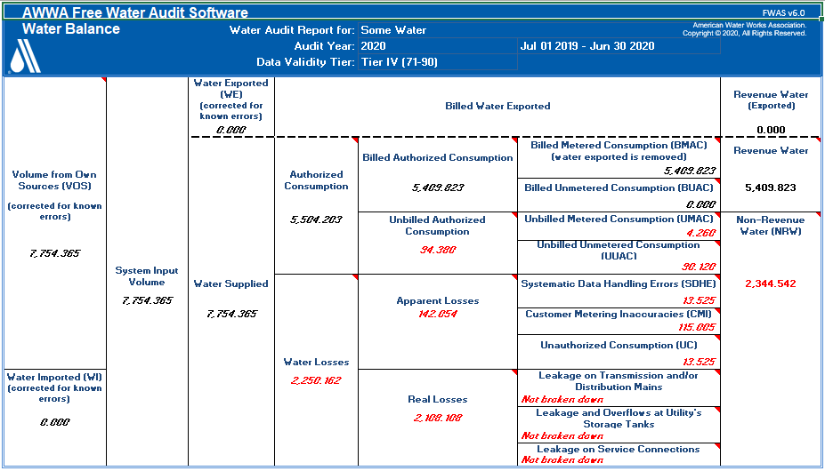
Water Balance Filled Out
Notes:
Balance sheet filled out.

Slide 64
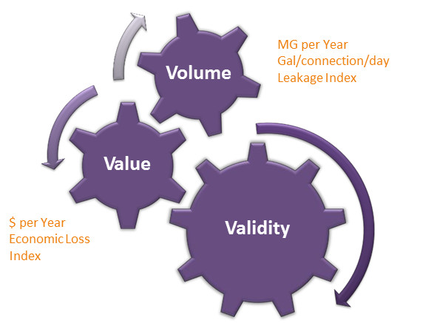
3-V

Slide 65
Water Audit Quality & Validation Levels
The Data Validation Process includes five levels of data quality which are defined below:
  Self-reported – data has been collected, but not been subject to any in-depth review.
  Filtered – data has been checked for technical plausibility by employing screening criteria, such as ILI < 1.0 or > 20.0
Data validation conducts an in-depth review of the data sources and practices of the water utility
  Level 1 validated - focuses primarily on the suitability of the data gradings assigned to the various inputs, with scrutiny on the data inputs to flag gross or egregious errors.
  Level 2 validated - in-depth investigation of various input data and information of one or more components of the water audit. This is still largely a desktop activity.
  Level 3 validated - Bottom-up review and investigation into a single component or sub-component that collects new or additional data at a field/source level, and provides detailed analysis.
Notes:
WRF research projects in 2015 and 2016 have established these levels of validation.

Slide 66
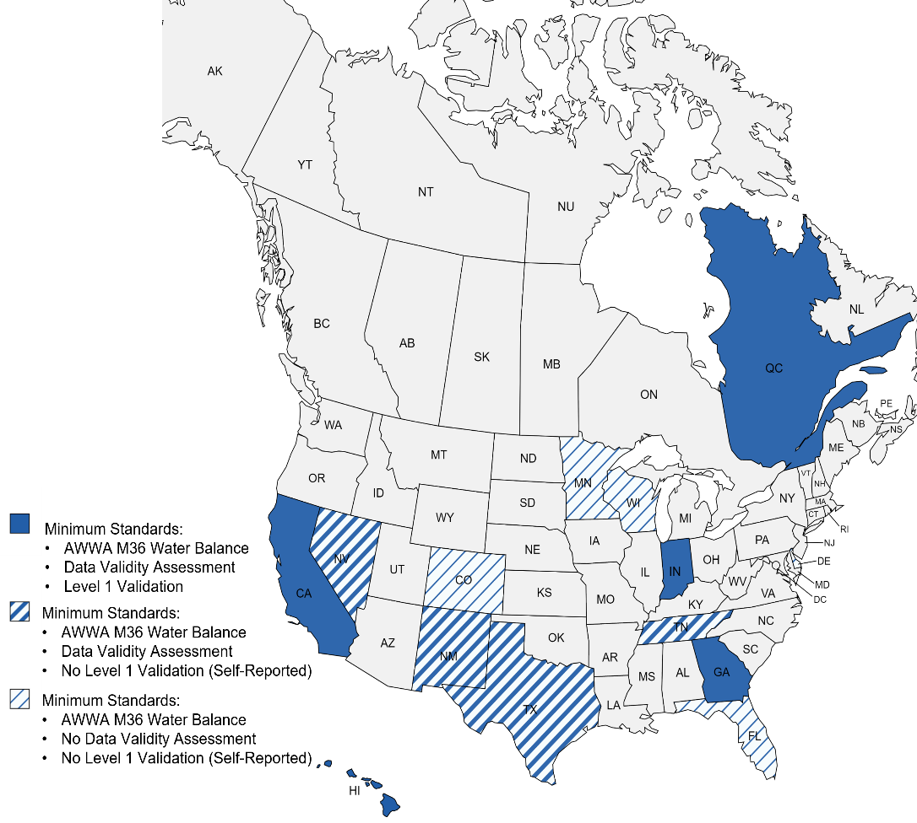
Level 1 Validation Regulatory Requirements
US States (4) and the Province of Quebec require Level 1 water audit validation
Notes:
Using the compiler to look at how your audit compares to validated datasets, and how your audit trends in your own utility over time is part of what is called a Level 1 validation –
Let’s put that in context

Slide 67
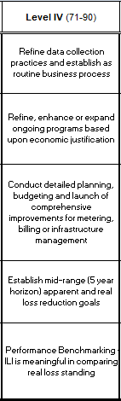
Loss Control Planning tab
Functional Focus Areas
Audit Data Collection
Short Term Loss Control
Long Term Loss Control
Target Setting
Benchmarking

Slide 68
Developing Actions
  Monitor, Maintain and / or Manage
  Improve data
  Develop a “bottom up” audit
  Refer to M36 and other AWWA references
  Other publications, IWA and privately authored
  Review case studies
  Comments to wlc@awwa.org
Notes:
Matrix allows for loss control planning.

Slide 69
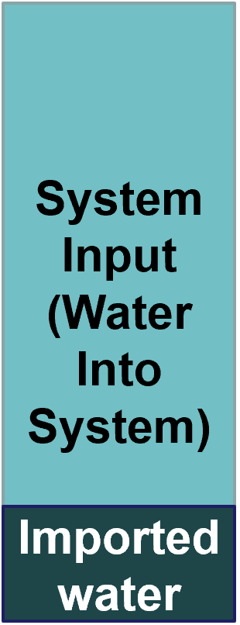
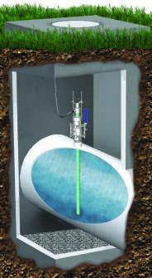
Evaluating Production Flowmeter accuracy
Accurate flow data is critical, and dependent on:
  Proper type & size of flow meter
  Unobstructed flow meter setting
  Proper flow meter upkeep
  Reliable data trail management
Accuracy testing quantifies flowmeter performance in the setting
  Tank/clearwell Drop Test
  Comparative flow testing in situ
  Testing at a test facility
Photo courtesy McCrometer
Notes:
And how can a system test how well its plant facility measures flow and volume? There are a variety of metering methods. The graphic shows the use of insertion meters that consultants and some vendors can provide to check on accuracy (within about 1%). An in-house method if you have a clearwell facility or nearby standpipe is volumetric testing as described on the slide. Calibration does not mean looking at the system telemetry output only, it is verifying the mechanical measurement method.

Slide 70
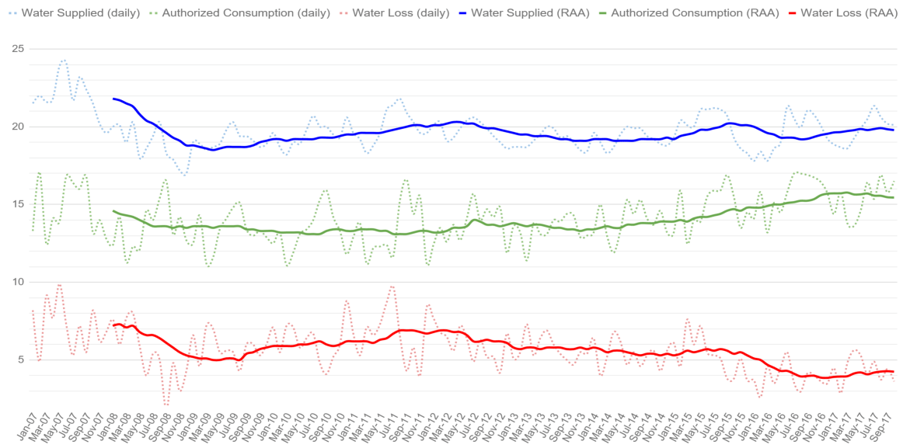
Tracking Water Audit Data
Reliable Long-term Water Loss Trend is revealed via Rolling Annual Average (RAA)
When going to a hotter and drier summer, expect lower NRW in spring as supply moves ahead and higher NRW in the fall when supply drops.
Water Loss Trend
Notes:
This slide shows how twelve-month average levels the unevenness shown in the last slide (as long as meters are read more or less the same day at the end of each year)

Slide 71
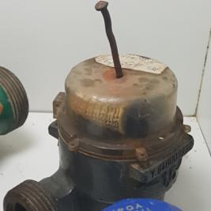
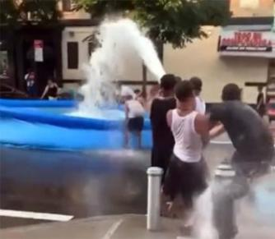
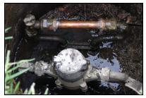
Apparent Losses
May be difficult to quantify…
Systematic Data Handling Errors – found in meter reading and billing processes
Customer meter inaccuracies
  Uncalibrated
  Wrong size or wrong type
Unauthorized consumption
  Meter tampering
  Illegal taps
  Theft at hydrants
  Open unmetered bypasses
  Illegal use of fire services
Photo courtesy Kamstrup
Photo courtesy NY Daily News
Photo AWWA M36 Manual
Notes:
The thing to remember about apparent loss is it usually represents something that you sell (or could sell) at full retail cost as opposed to leakage which is valued at production cost. Unauthorized use could be inadvertent customer error or outright theft. Metering and billing inefficiencies make up the other causes.

Slide 72
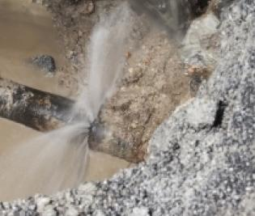
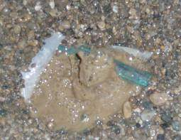
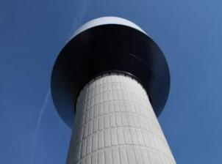
Real losses
Leakage on mains
Leakage on service lines
Storage facilities’ leaks and overflows
The water audit calculates Real Loss as a “catch all” top-down value as NRW minus two other NRW items:
  Unbilled Authorized Consumption
  Apparent loss
Leakage can be measured in “bottom-up” fashion by tracking flows in District Metered Areas (DMA)
Photo courtesy PA American Water
Notes:
Many people assume that there is one bad leak when the NRW is high. It is more commonly an accumulation of small hidden leaks that are undetected for extended periods of time. Storage leaks often occur when a tank operates near the overflow level. Leaks occur on the customer side of service lines. Tank leaks are not usually as spectacular as the seen in the pictured tank, generally there is an overflow pipe that takes water away discreetly.

Slide 73
The Water Cost of Real (Leakage) Loss
SHORT-TERM, DIRECT COST VALUATION
Real losses and unbilled authorized consumption (UAC) cost the incremental amount of money it takes to produce the water (Variable Production Cost) or the unit purchase cost if bulk water is imported.
If recovered leakage and UAC could be sold to an expanding customer base in a system with constrained water supply, it can be valued at the retail price.
LONG-TERM, INDIRECT COST VALUATION
If a capital project to increase supply or delivery capacity can be avoided or delayed, that cost should be added.
If leakage reduction can improve instream flow availability and product environmental benefits, a cost can be calculated to account for this benefit
Real losses
Notes:
Water leakage is usually costing you at the rate it costs to make water. Apparent loss is lost sales so the retail rate applies. If water supply is very limited (or if new projects will be needed to offset losses – pump stations, etc.) the cost of leaking water is higher.

Slide 74
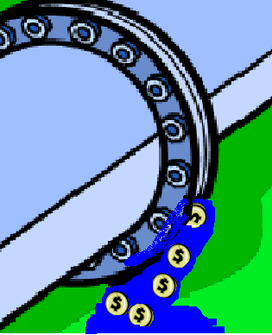
Tracking Non-revenue Water
Regulations
  Many states require the largest cities, towns and private water companies, to keep the rate of Lost and Unaccounted for Water to 10 percent or less.
How should NRW be measured?
  Percentages are misleading, as they are skewed by variations in customer consumption demand, and are not actionable for apparent/real loss control
  AWWA NRW performance indicators (by the mile, by customer count) are more relevant and effective
Establishing loss reduction targets
  Should take into account full value and pricing of the water supply, applicable secondary impacts and costs of activities to control specific losses
Notes:
So are there regulatory limits – usually depending on the state. Western states tend to have a stricter minimum standard because systems are not as old, and water supplies are more scarce. States are slowly adopting the AWWA method. Some states are still holding on to outdated methods (UAFW).
A regulatory issue can add importance to analyzing to estimate leakage and then follow with the economics to evaluate what might be saved with a proactive program. The Water Audit is being required at an increasing rate.

Slide 75
Final Note
In the United States alone, an estimated 6 billion gallons of treated water are lost every day, mainly due to leaks and aging infrastructure. This not only wastes a precious resource — one that is growing increasingly scarce as climate change intensifies — it wastes thousands of dollars that utilities can’t afford to lose.
To start to tackle this problem, President Biden signed the Infrastructure Investment & Jobs Act into law in the fall of 2021, allotting $50 billion specifically to improve the nation’s drinking water and wastewater systems. This marks the single largest investment in clean water ever made by the federal government.
Historically, the US hasn’t invested in infrastructure as well as we could have, On top of that, our infrastructure is coping with a growing population that is growing at a frantic rate in certain parts of the U.S. and utilities are trying to keep on top of their aging infrastructure, parts of which are 150 years old and even older. The fact that the government has decided to release some long-needed investment in the infrastructure of the vastly under-maintained, overused system is simply brilliant.

Slide 76
Final Note (con’t.)
Part of the funding is allotted towards improving the operational sustainability of small public water systems that serve fewer than 10,000 people. The act defines operational sustainability as the ability to improve the operation of a small system through the identification and prevention of potable water loss due to leaks, breaks, and other metering or infrastructure failures. Organizations that receive funding must use those funds to carry out projects that improve the operational sustainability of their systems, such as deploying leak detection and metering technology.
This funding is incredibly important for those smaller utilities and smaller cities to be able to make sure that they can bring their infrastructure up to the current standards or the current best practice.
The Water Audit is an important first step to this process.
because it tells you where to look for the losses!

Slide 77
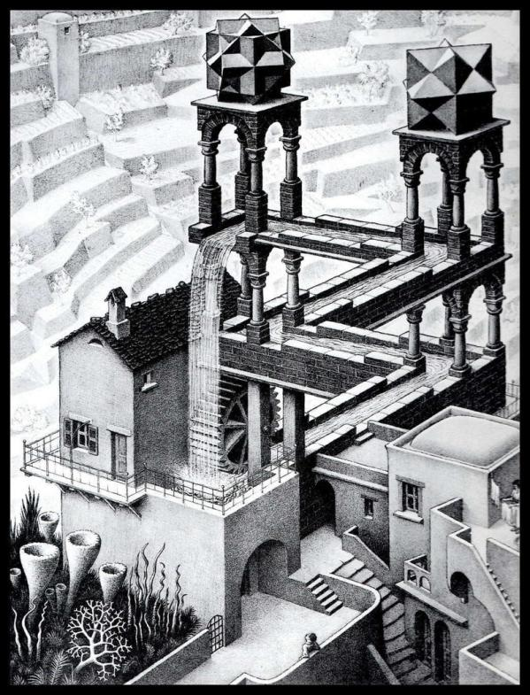
Questions?
  John H. Van Arsdel, Vice President
  john@mesimpson,com

